Slide 1
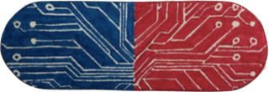
Smart Pill Box
Managing Your Medicines Just Became Easy

Slide 2
Big Data
40,061,742 are older than 60 years old in U.S.
27.1% of population are older than 60 years old.

Slide 3
Big Data
7 out of 10 Americans take at least one prescription medication daily.
12% of all primary care patients may be affected by a monitoring error; 38% in those 75 years and older.

Slide 4
I don’t use any smart devices. I hope there will be something help with my meds taken… But not require using smart devices… I always forget what meds I have to take. My kids worried a lot...
--- Female, 82, Beijing

Slide 5
Problem
Technology didn’t help with Medicine Intake.
Reminders always on Smart Devices.
Caretakers worried about their loved ones.

Slide 6
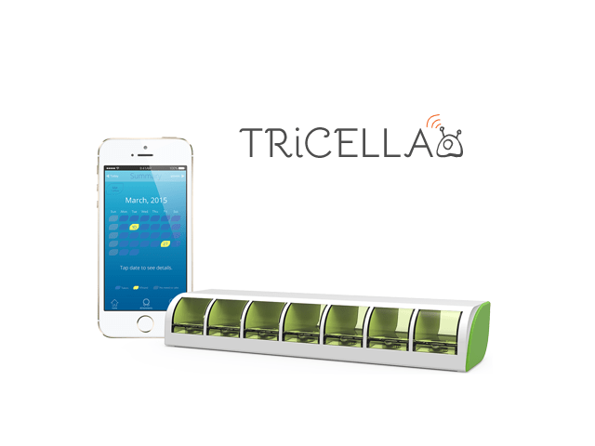
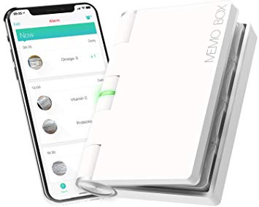
Competitors
$80
$120

Slide 7



Solution:
A Smart Pill Box at home and a web-app to
Show Care
to loved ones
Share Data
with Family
Track Intakes Patterns
of Medicines

Slide 8
Product Demo

Slide 9
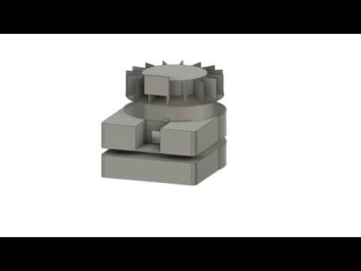
Model Animation

Slide 10
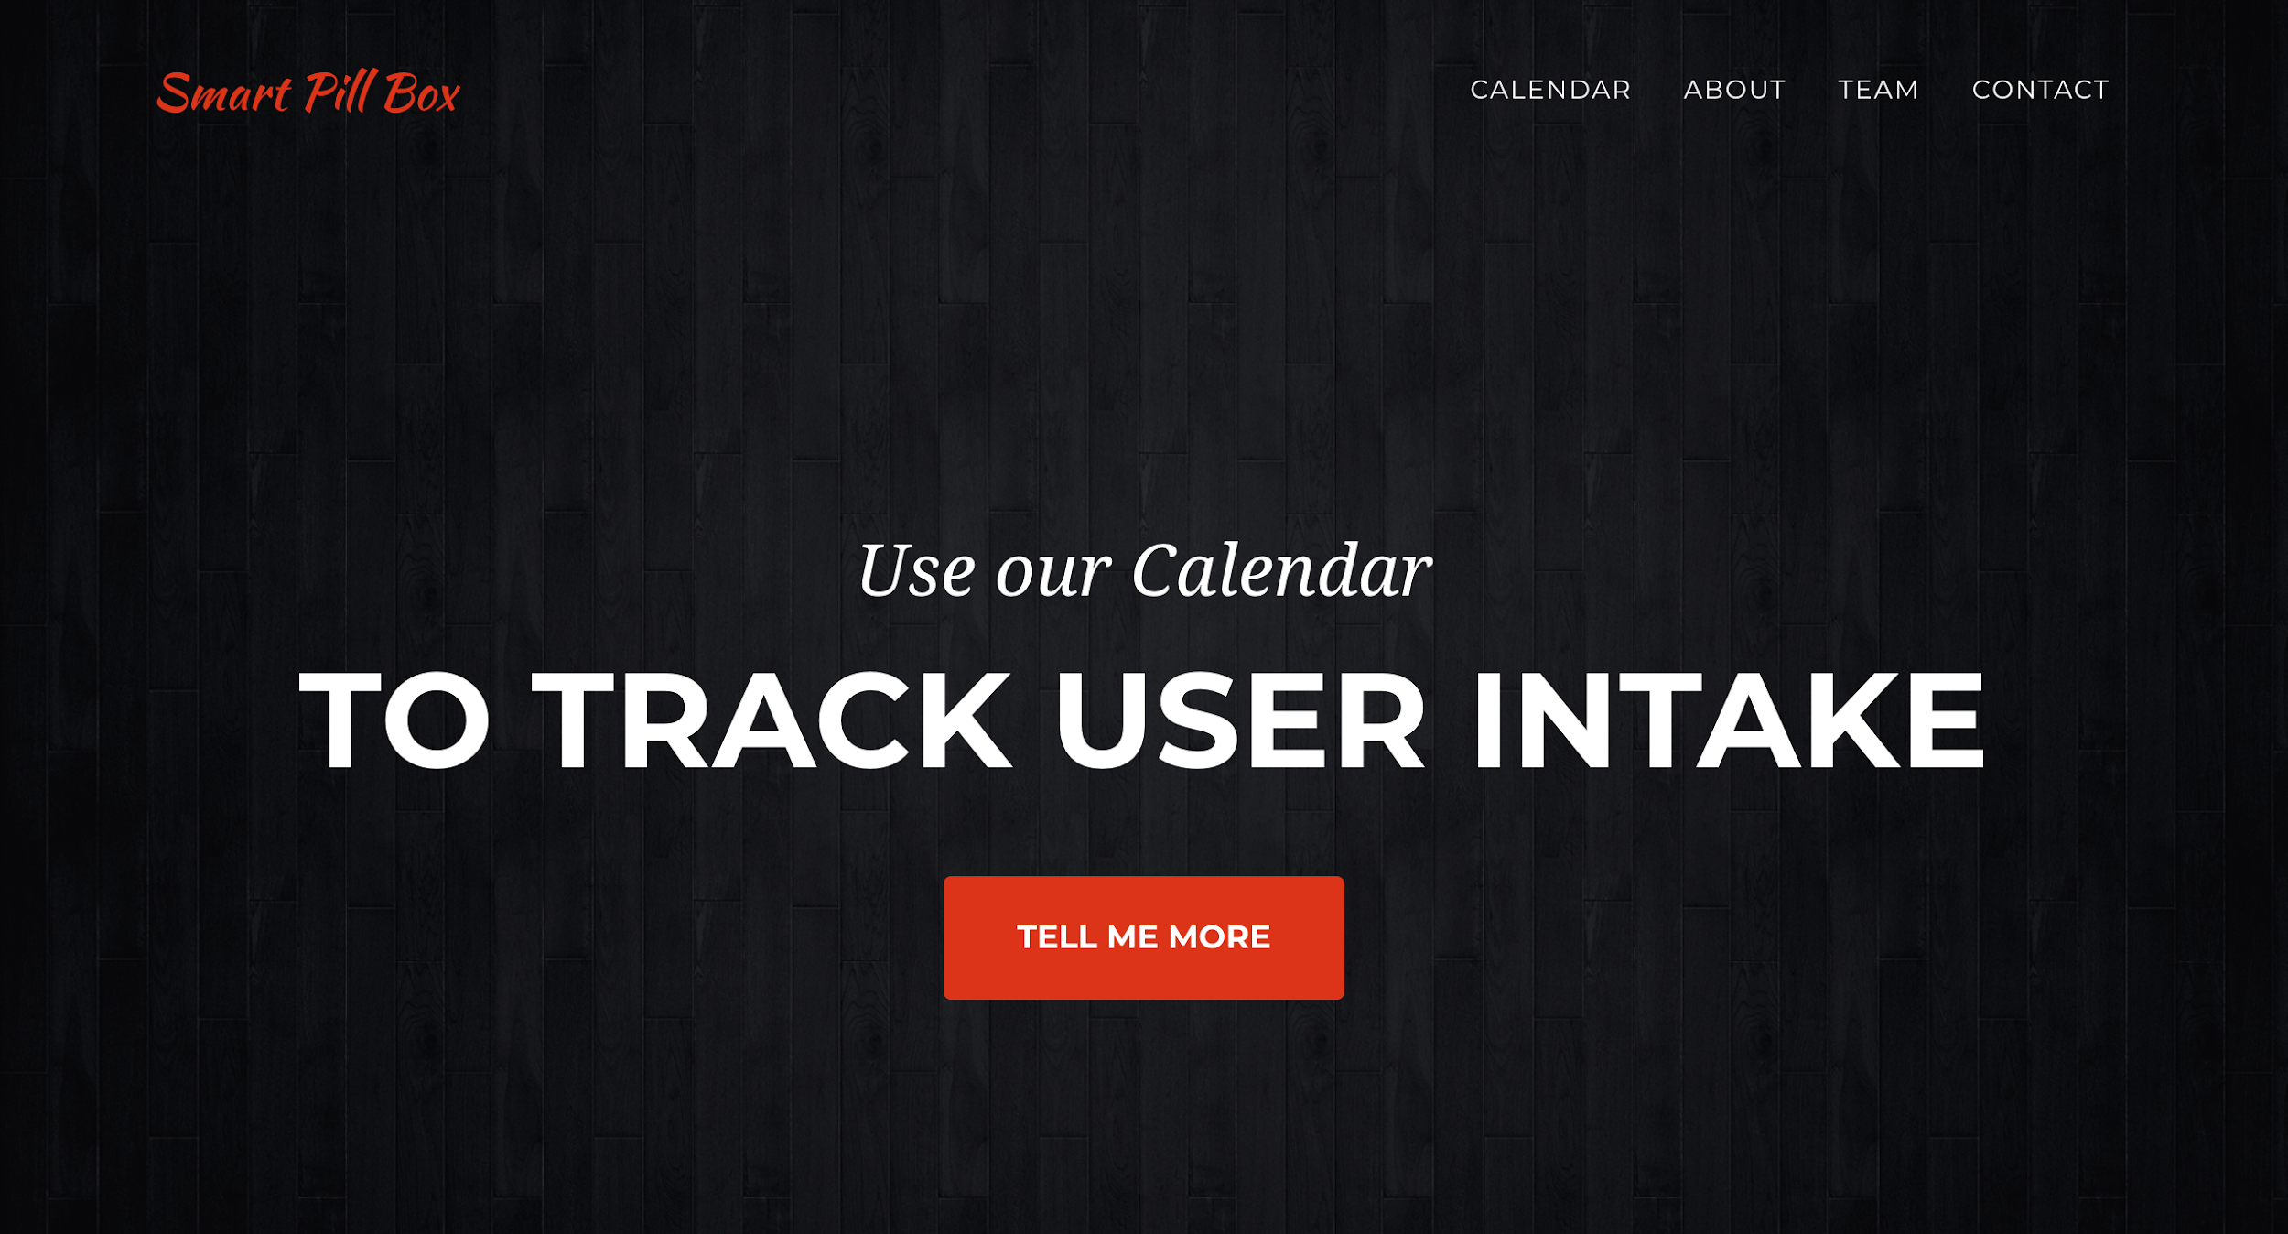

Slide 11
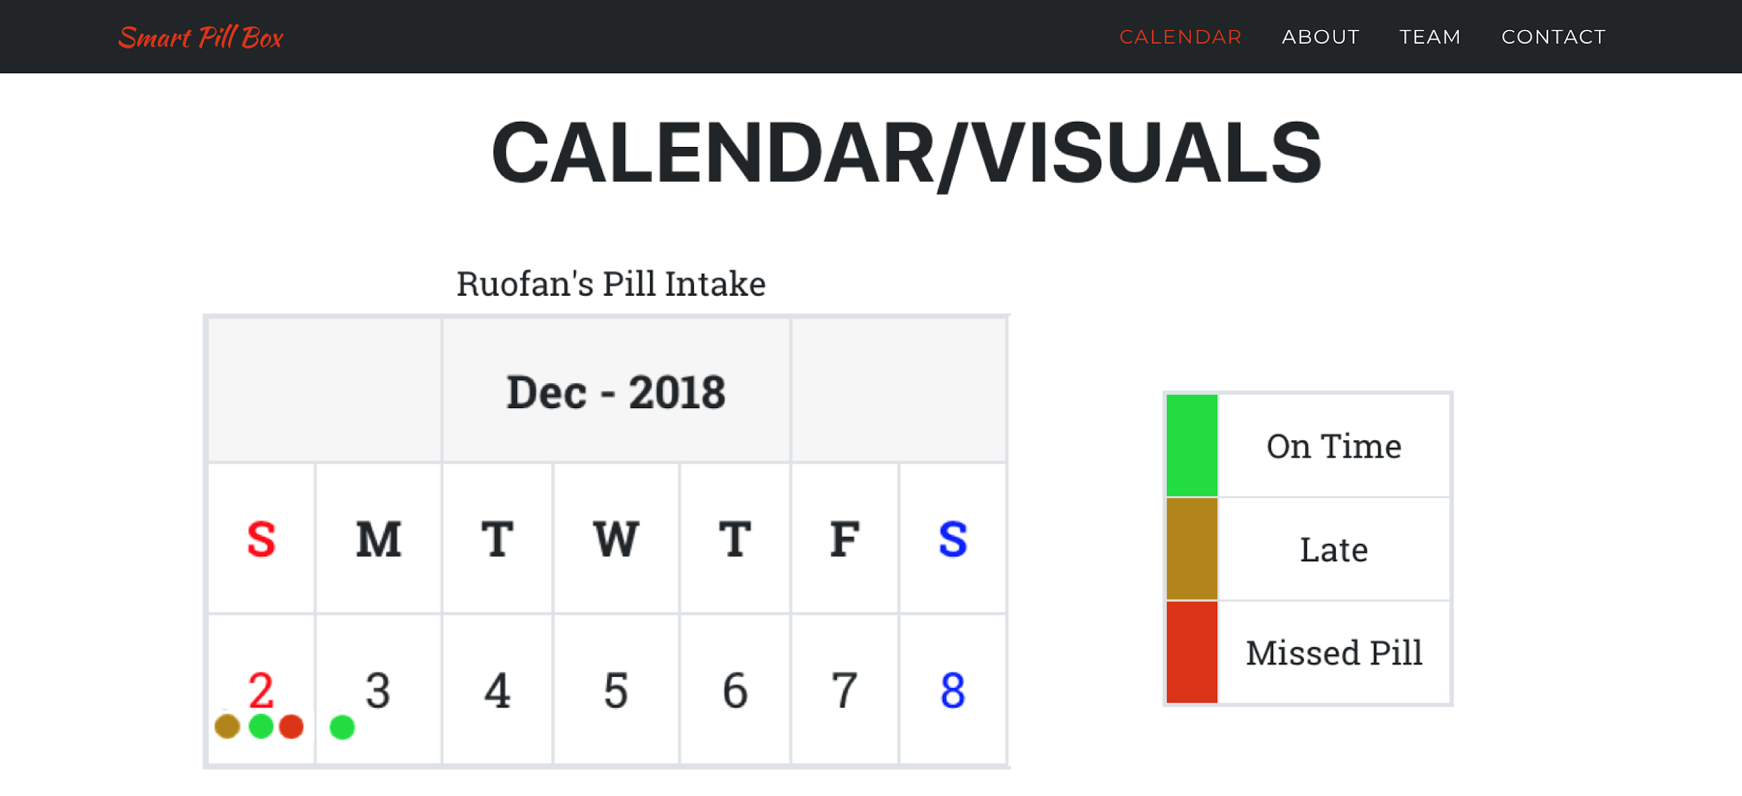

Slide 12
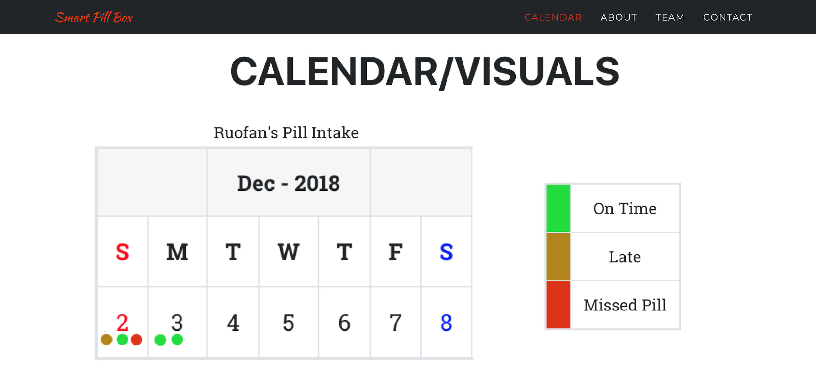

Slide 13
Our Progress
Sept.
Oct.
Nov.
Exploring Amazon Alexa
Shift the directions to build the protopype
Prototype Building by using 3D Printer
Building functionalities on Raspberry Pi
Prototype improving and finalized
Website building and finalized

Slide 14
Future

Slide 15
Functionality
Auto sorting medicines
Form factor
Reminder with Machine Learning Algorithms

Slide 16
Funding
Cost of Production
200,000 to put product into production
400,000 for team salaries for the first year
10 dollars (Raspberry Pi & Stepper Motor)

Slide 17
Thanks You!
Any questions?

Slide 18
Credits
Thank you for marketing group for creating the logo.
Social Explore
https://www.socialexplorer.com
World Health Organization
http://www.who.int/

